Slide 1

Data Science Project: Movie Scripts
Group members:
Victor Pansegrau, Jonas Liebermann

Slide 2






The Features
Writer
Sentiment
Genre
Characters
Running Time
Year published

Slide 3
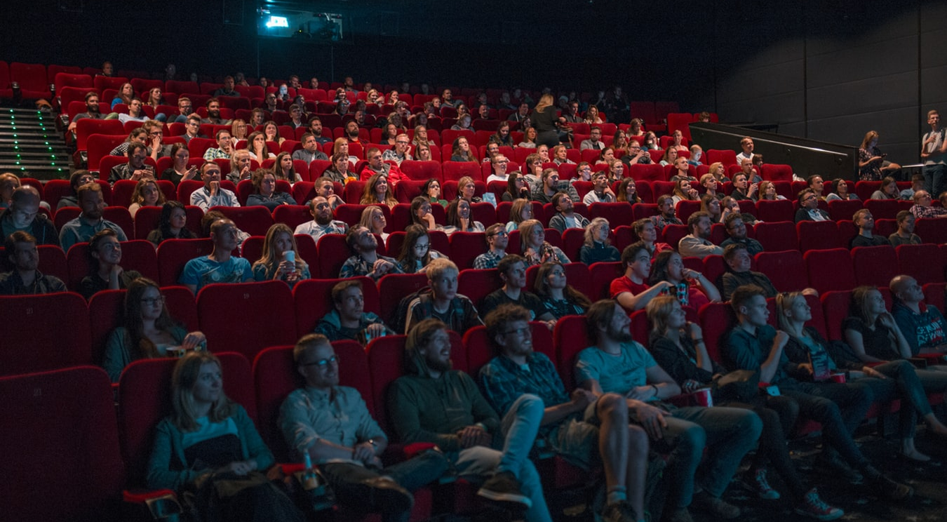
The User is…
…a cinephile

Slide 4

The Dataset 651 Dramas 406 Thrillers 395 Comedy 335 Action 231 Crime 210 Romance 1160 Scripts total
Scraped from imsdb.com

Slide 5
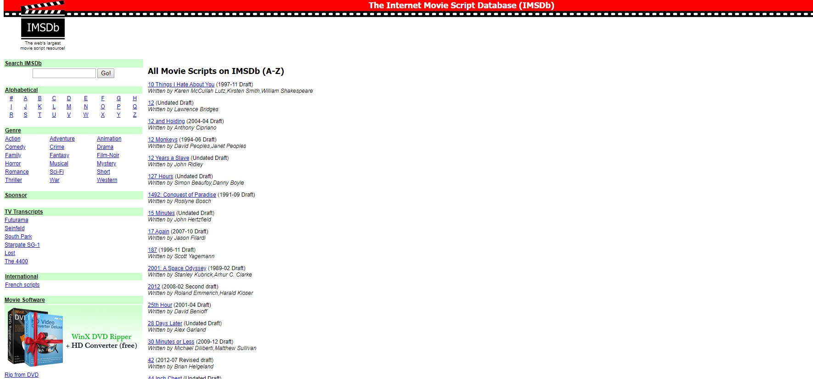
The List

Slide 6
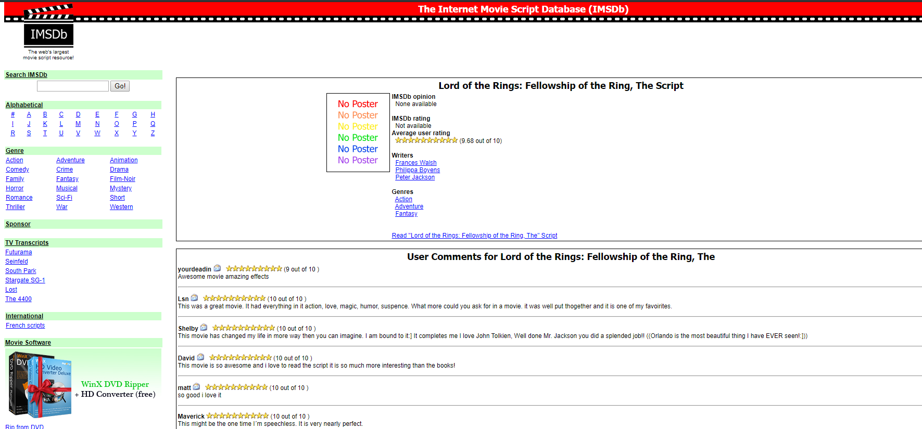
The Movie Page

Slide 7

The Code

Slide 8
Sources
Images (in order of appearance):
https://unsplash.com/photos/paCF_o4FGwg
https://unsplash.com/photos/AtPWnYNDJnM
https://buyyourproduct.com/wp-content/uploads/The-Problem-With-the-IMDB-Top-250-Movie-List-1.jpg
https://unsplash.com/photos/ieic5Tq8YMk

Slide 9



Thank you for your attention!
Victor Pansegrau
Jonas Liebermann
s0563822@htw-berlin.de
s0563579@htw-berlin.de

